Slide 1
Trading Sentiment Analysis in Decentralized Cryptocurrencies

Slide 2
Quick reminder
What is sentiment analysis ?
Sentiment analysis is the process of using natural language processing to identify, extract, and quantify subjective information from text, determining whether the expressed sentiment is positive, negative, or neutral.
Notes:
Sentiment analysis is the process of using natural language processing to identify, extract, and quantify subjective information from text, determining whether the expressed sentiment is positive, negative, or neutral.

Slide 3
tools
Google Trends - https://trends.google.com/trends?geo=VI&hl=en-US
GPT-4o
https://chatgpt.com/
Python API – Pytrends

Slide 4
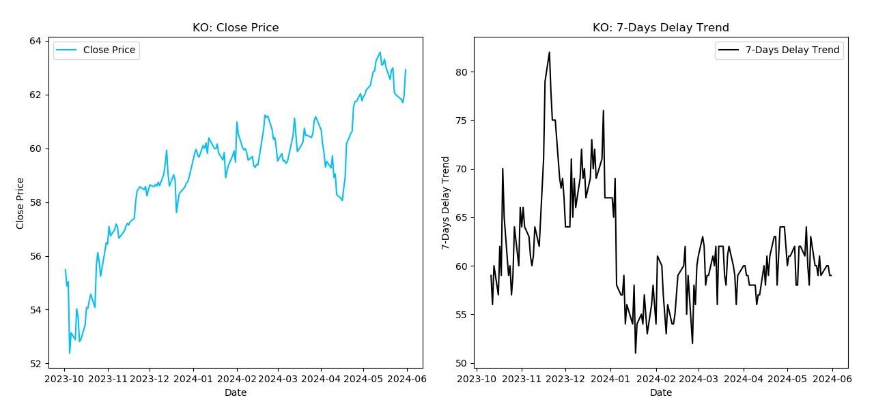
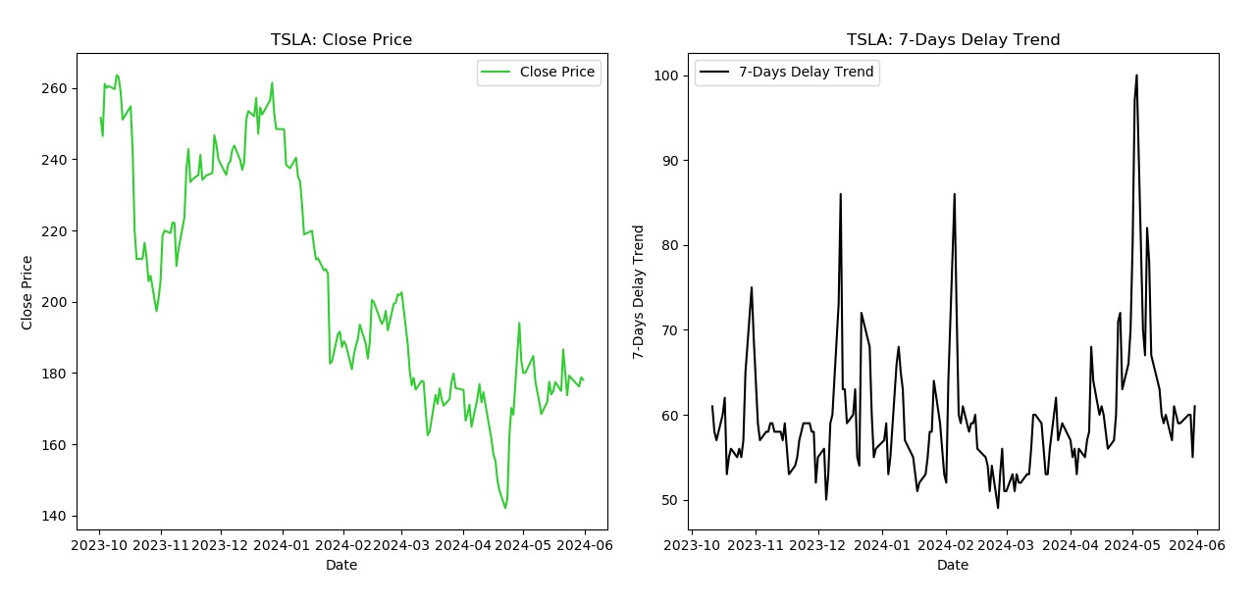
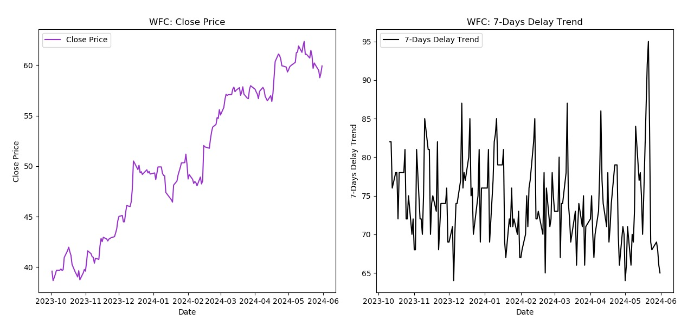
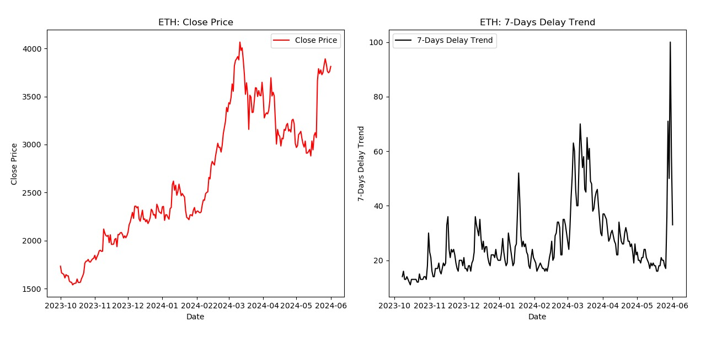
Evidence

Slide 5
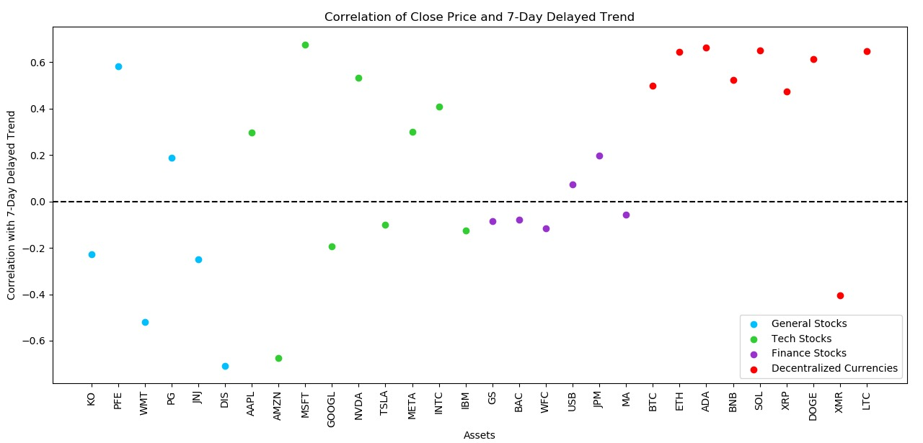
Evidence
The Crypto-Market has Higher Correlation to it’s Trend Compared to Other Sectors

Slide 6
What are we trying to achieve
Aka how we’re going to get rich
Simple idea, hard fine tuning. Our algorithm monitors search trends and sentiment analysis of crypto currencies related keywords. When it detects a significant increase in search frequency for a stock, it signals a potential buy opportunity, anticipating a price rise. How exactly? Come check our code!

Slide 7
Any question?

